Slide 1
Activity Planning
Peter Carlyle

Slide 2
What is an activity plan
Defines the what when where and how long elements of a project will take.
Aim to
Facilitate overall delivery
Use Resources Adequately
Assist with motivation, keeping progress going
Coordinate what needs to be done and when

Slide 3
Separating Project from Activity
A project is a large, often complicated non routine deliverable component or software.
An activity is a part of a project. This will usually be small part. Delivery of a function of the global project.
In a website – Integration of payment gateway

Slide 4
Activity Approach
A list of all activities
Identifying the order in which they need to be delivered – Dependences
Tasks that are high level the task required
These can then be broken into lower level the things that need to be done to deliver a high level task

Slide 5
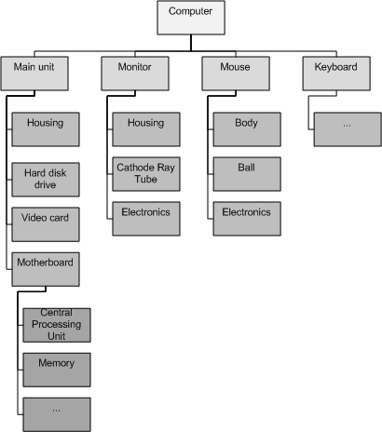
Product Approach
This defines a flow of products that are required as imputes
Each product has components that is
Further dependent on

Slide 6
Hybrid Approach
A list of deliverables
For each the activates to deliver the higher level is defined.
These are integrated into many software methodologies
IBM defines levels
1. Project 2. Deliverable 3. Component 4. Work Package 5. Tasks to complete the package
Each feeds back a level up to the previous step. When all at a level are complete the level is completed.
https://www.ibm.com/developerworks/rational/library/2831.html

Slide 7
Agile
Agile is a hybrid methodology
Prioritising the components, the products that need to be delivered.
Looking at shortened time often around 2 weeks delivering a product or a functioning element
Designed to help teams work on a project

